Slide 1
OHDBNet: Octave Half Dilated Bottleneck Network with Mixed Loss for Real-Time Semantic Segmentation
學生 劉亮昆
指導教授 張隆紋

Slide 2
Outline
Introduction
Related works
Methods
Datasets
Experiments
Results

Slide 3
Introduction
Methods
Datasets
Experiments
Results
Related works
With the recent rise of research on robotics and automatic driving, for the sake of being able to run deep learning networks on limited resources while pursuing real-time, it is necessary to strike a balance between accuracy and speed.
Our network can effectively reduce the number of parameters, and have a high speed while maintaining good enough predicted results, so our network can be applied to real-time semantic segmentation.
Notes:
近期隨著機器人、無人駕駛的研究開始興起，為了能夠在有限的資源上運行深度學習的網路的實時性(real-time)，必須要在精確度和速度中找到一個平衡。
我們的網路主要是透過減少參數量、計算量，而且在維持足夠好的預測結果下擁有相當高的速度，因此我們的網絡可以應用於實時語義分割。

Slide 4
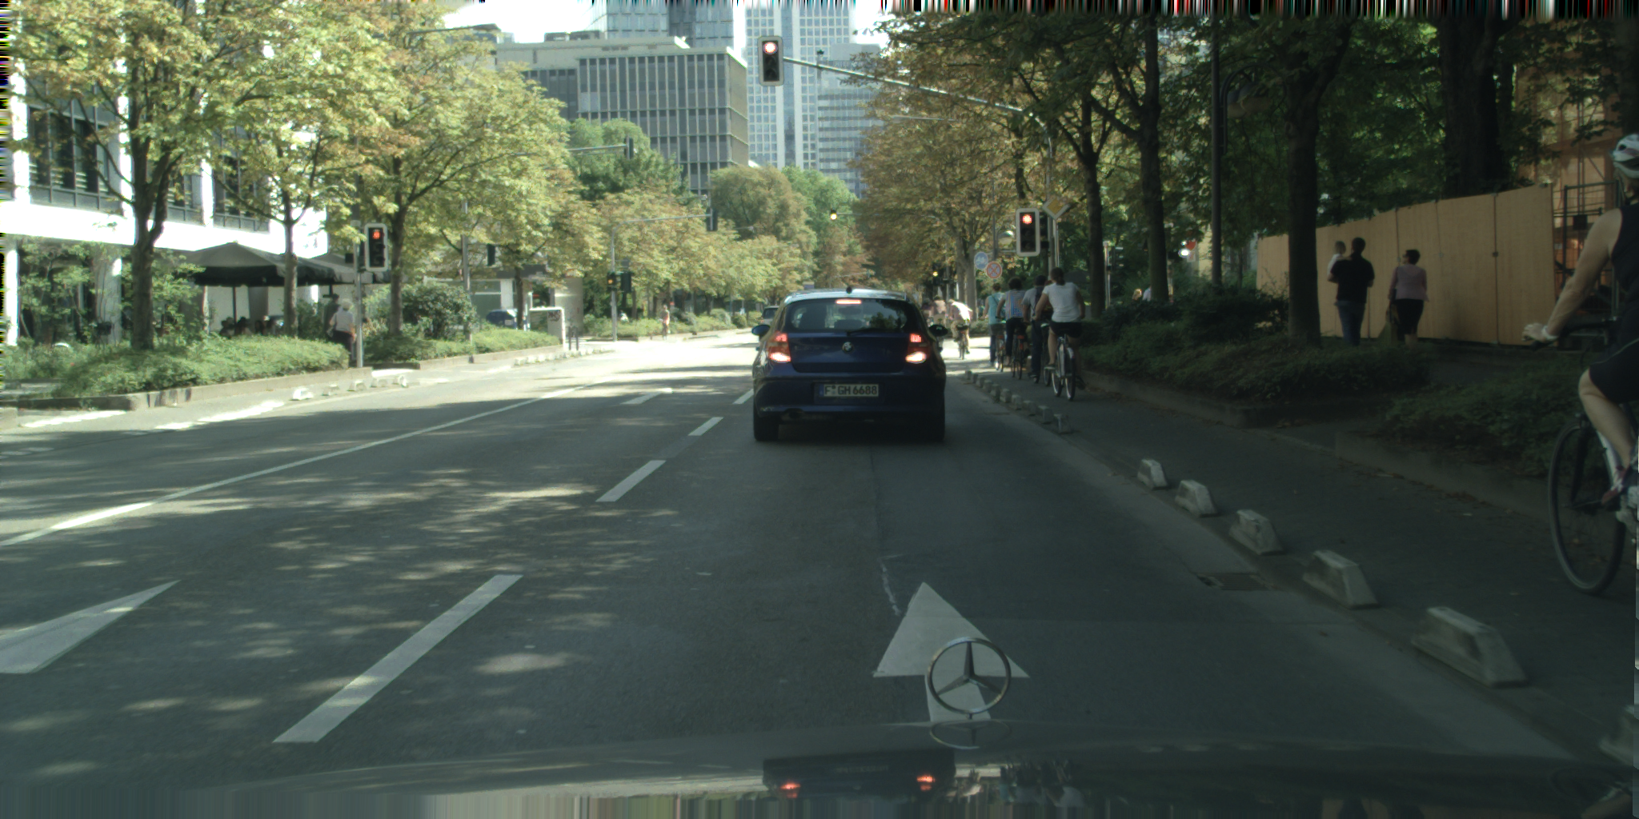
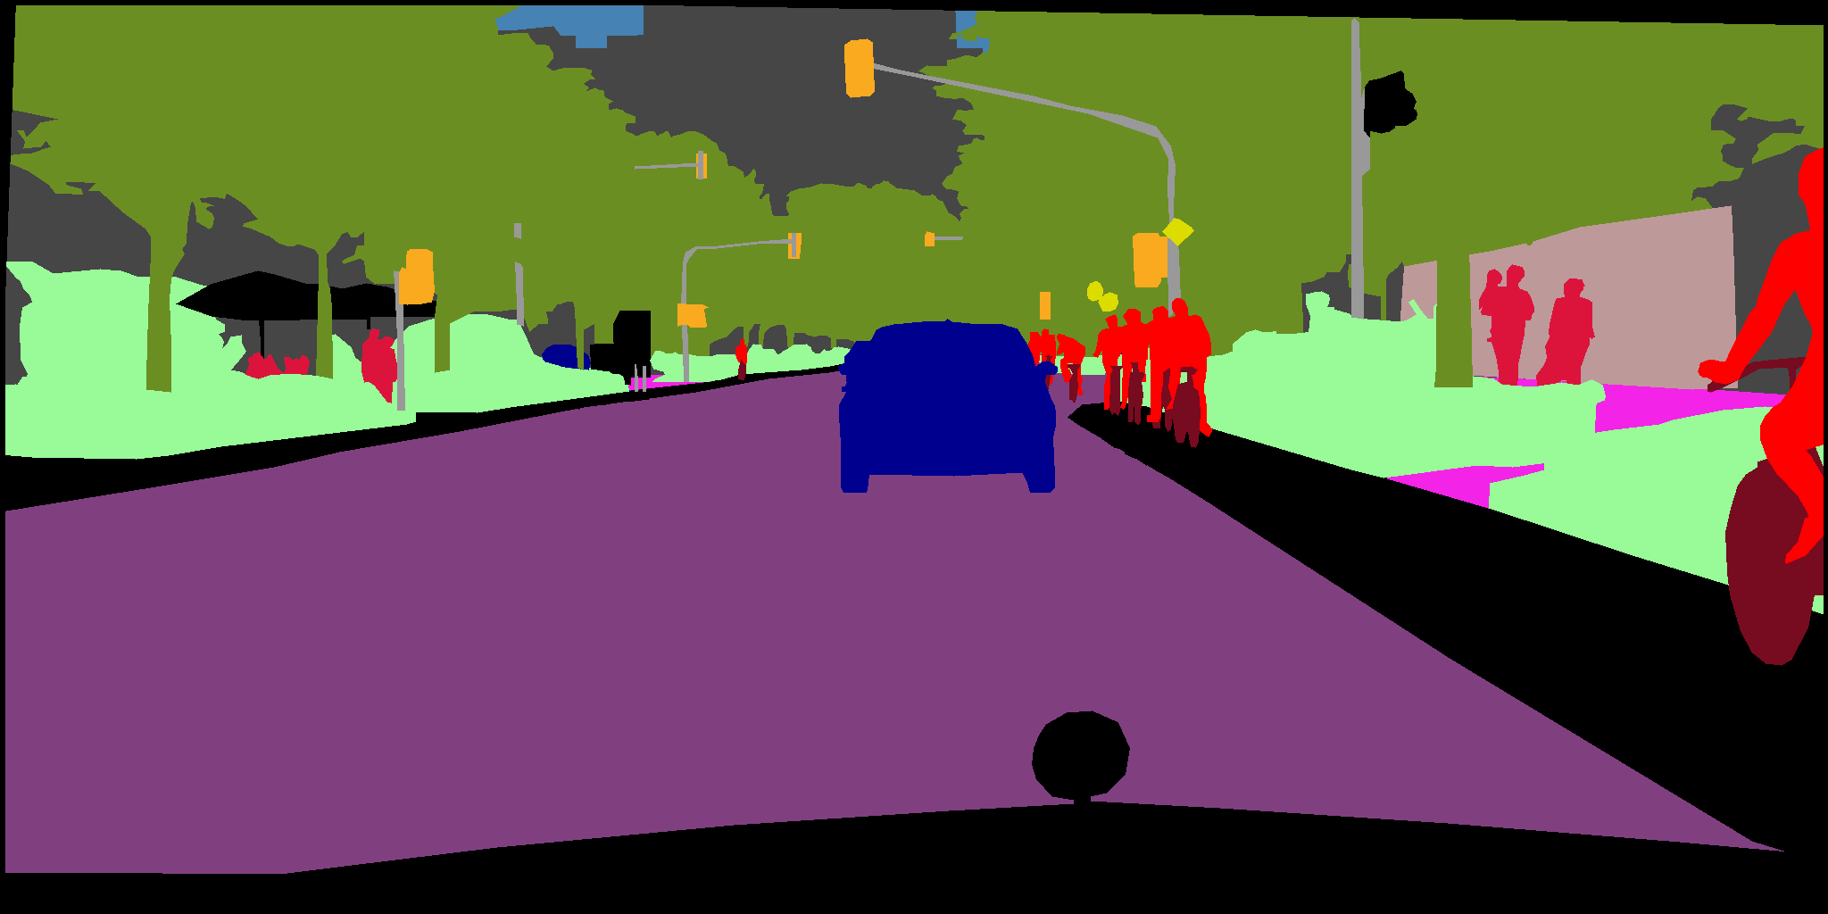
Introduction
Methods
Datasets
Experiments
Results
Related works
road | sky
sidewalk | person
building | rider
wall | car
fence | truck
pole | bus
traffic light | train
traffic sign | motorcycle
vegetation | bicycle
terrain | unlabeled
Notes:
所謂的Semantic segmentation 就是在pixel-level的層級上 對一個圖像進行分類。
也就是說，可以看到圖上，每一個像素都會對應到一個物件，藍色的是車子、紅色的是人等等

Slide 5
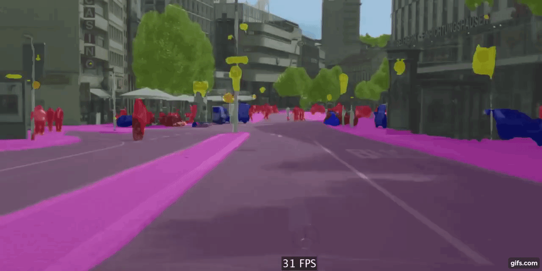
Introduction
Methods
Datasets
Experiments
Results
Related works
---From Youtube video

Slide 6
Introduction
Methods
Datasets
Experiments
Results
Related works
Dilated Convolution
DeepLab Series [2] – [5]
DABNet
Depth-wise Asymmetric Bottleneck [1]
Octave Convolution
Drop an Octave [10]

Slide 7
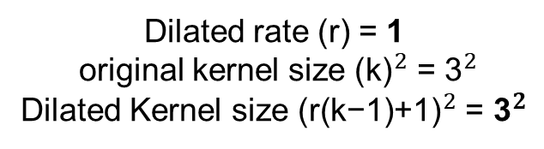
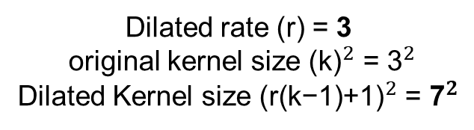
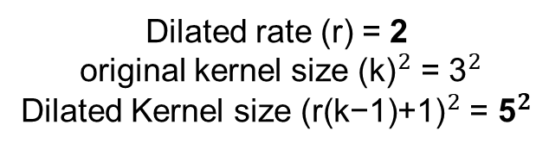
Introduction
Methods
Datasets
Experiments
Results
Related works
Dilated Covolution
Dilated rate (r) = 1
original kernel size ${\text{(}\text{k}\text{)}}^{2}$ = ${\text{3}}^{2}$
Dilated Kernel size ${\text{(}\text{r}\text{(}\text{k}\text{−1)+1)}}^{2}$ = ${\text{3}}^{2}$
Dilated rate (r) = 2
original kernel size ${\text{(}\text{k}\text{)}}^{2}$ = ${\text{3}}^{2}$
Dilated Kernel size ${\text{(}\text{r}\text{(}\text{k}\text{−1)+1)}}^{2}$ = ${\text{5}}^{2}$
Dilated rate (r) = 3
original kernel size ${\text{(}\text{k}\text{)}}^{2}$ = ${\text{3}}^{2}$
Dilated Kernel size ${\text{(}\text{r}\text{(}\text{k}\text{−1)+1)}}^{2}$ = ${\text{7}}^{2}$
(a)
(b)
(c)
Notes:
擴展的內核大小表示一個更大的有效接收域，與原始內核大小相比，該字段可以獲取更多的圖像信息，而無需增加參數數量。
但是會增加計算量

Slide 8
Introduction
Methods
Datasets
Experiments
Results
Related works
DABNet
BN + PReLU
3x3, W/2
1x1, W/4
3x1, W
BN + PReLU
Standard
convolution
ReLU
BN + ReLU
1x3, W
3x1, W/2
3x1, W/2
3x3, W/4
BN + ReLU
BN + PReLU
Depth-wise
convolution
BN + PReLU
BN + ReLU
3x1, W
1x3, W/2
1x3, W/2
1x1, W
ReLU
Depth-wise Dilated
convolution
BN
1x3, W
BN + PReLU
BN
1x1, W
Add
ReLU
ReLU
W
Output Channels
(a)ResNet bottleneck
(b)ERFNet non-bottleneck-1D
(c) DAB module

Slide 9
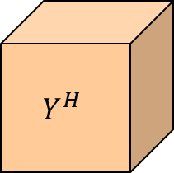
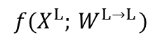
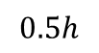
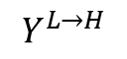
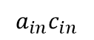
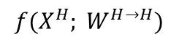
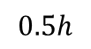
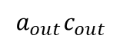
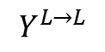
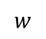
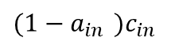
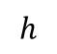
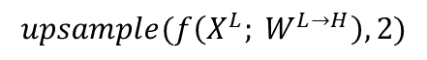
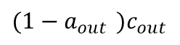
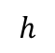
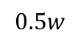
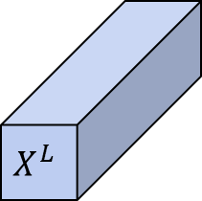
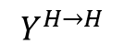
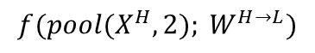


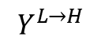
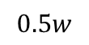
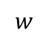
Introduction
Methods
Datasets
Experiments
Results
Related works
Octave Covolution
$(1−a_{in}$ $)c_{in}$
$$f(X^{H}; W^{H→H})$$
$(1−a_{out}$ $)c_{out}$
$$X^{H}$$
$$Y^{H→H}$$
$$Y^{H}$$
$$f(pool(X^{H},2); W^{H→L})$$
$$h$$
$$h$$
$$w$$
$$Y^{L→H}$$
$$w$$
$$Y^{L→H}$$
$$a_{in}c_{in}$$
$$X^{L}$$
$$upsample(f\left(X^{L}; W^{L→H}\right), 2)$$
$$a_{out}c_{out}$$
$$Y^{L}$$
$$f(X^{L};{ W}^{L→L})$$
$$Y^{L→L}$$
$$0.5h$$
$$0.5h$$
$$0.5w$$
$$0.5w$$
Notes:
八度卷積具有兩個輸入和兩個輸出，並且輸入和輸出都可以分為高頻部分和低頻部分。高頻與低頻之比由α的值確定。
根據α的值，倍頻程卷積會將特徵圖劃分為高頻和低頻部分，並通過四個計算路徑輸出這兩個部分。兩條綠色路徑代表高頻和低頻特徵圖的信息更新，兩條紅色路徑促進兩部分之間的信息交換。
由於低頻特徵圖的大小僅為高頻特徵圖的四分之一，因此倍頻程卷積可以有效地減少計算量，但也有其局限性。
倍頻程卷積的輸出將分為高頻部分和低頻部分，但結果這兩個部分不能直接輸出。必須重新整合為完整的特徵圖，這意味著倍頻程卷積必須在相同的內核大小下至少使用兩次。

Slide 10
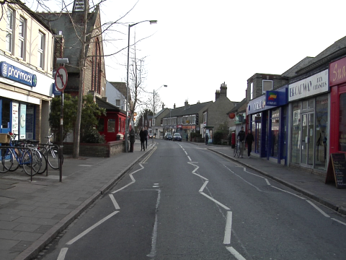
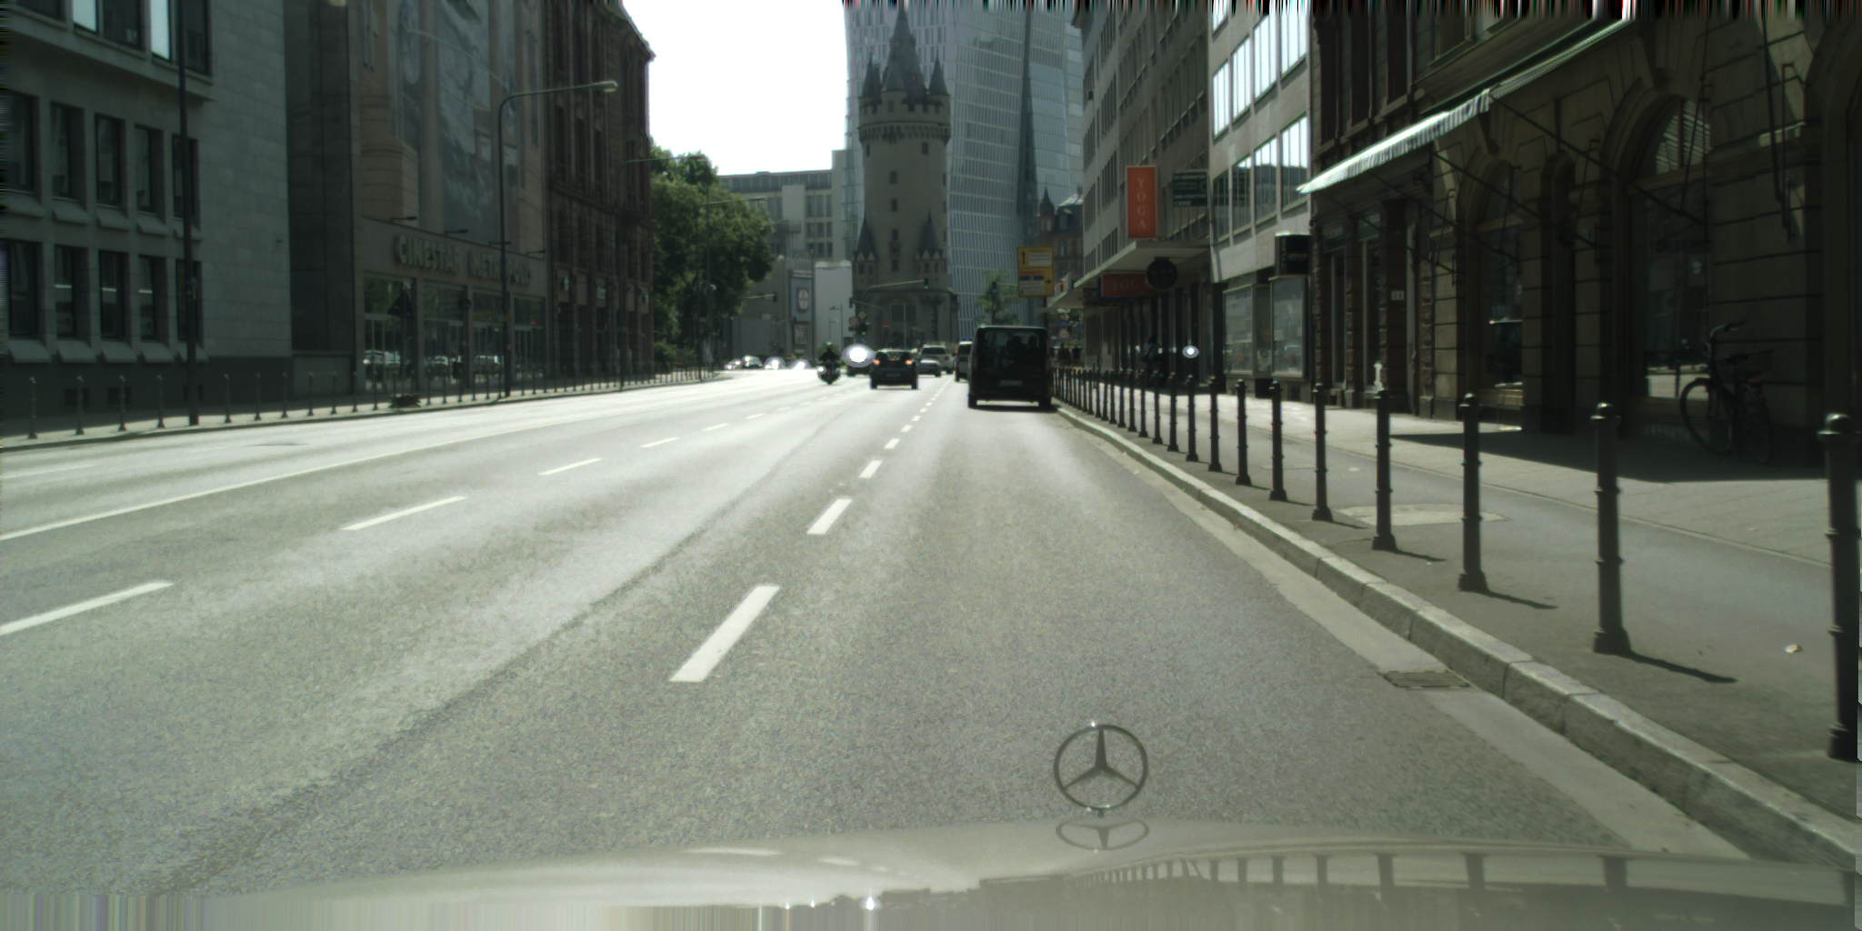
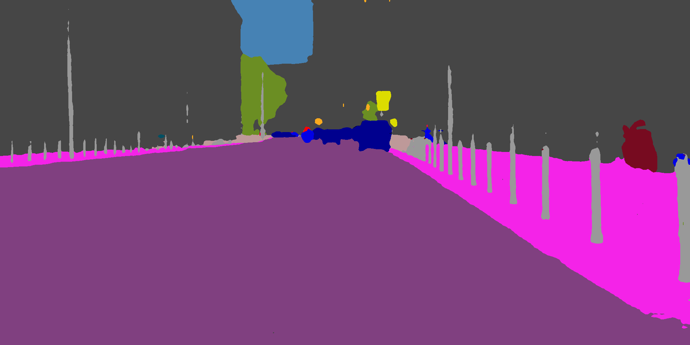
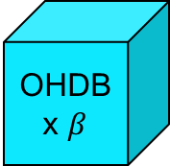
Introduction
Methods
Datasets
Experiments
Results
Related works
1/2 Image
1/4 Image
1/8 Image
3x3CONV
3x3CONV
3x3CONV
1x1CONV
OHDB
x $β$
OHDB
x μ
Ups
C
Downs
C
Downs
C
Image
Prediction
Standard
Convolution
Octave
Convolution
OHDB block
C
Concatenate
Down Sampling
Up Sampling
Notes:
圖4中提出的八度半擴展瓶頸網絡（OHDBNet）的體系結構類似於DABNet [1]。 在OHDBNet中，圖5中的OHDB塊用不同數量的OHDB模塊替換了DAB塊。
由於我們的研究試圖建立一個計算量少，參數少的輕量級模型，因此我們的網絡只有11層，因此可以分為表1中所示的四個部分。
前三個部分負責提取特徵圖。 最後一部分是輸出結果，然後在每個部分之間使用Concat。
在第一部分，有一個初始塊，該塊使用3 x 3標準卷積來擴展通道，並使用兩個八度卷積來提取圖像的特徵。第二部分和第三部分都包括用於特徵提取的下採樣塊和OHDB塊。
在第二部分中，下採樣塊是步長為2的3 x 3標準卷積和最大緩衝為2 x 2的級聯的連接，而OHDB塊中包含膨脹率為2的OHDB模塊。下採樣塊只是步幅為2的單個3 x 3標準卷積，
但是OHDB塊包含三個OHDB模塊，並且OHDB模塊的擴展速率分別為4、8、16。在第四部分中，最後一次Concat後，我們將使用1 x 1標準卷積和雙線性插值來生成最終結果。
我們使用一些遠程快捷方式連接和短距離快捷方式連接，它們可以促進功能複用和補償信息丟失。
在每個部分之間，遠程連接將原始圖像降採樣為特徵圖的相同分辨率，然後將它們連接在一起，
而短距離連接則將特徵圖連接在一起，這些特徵圖是在第二個和第三個OHDB塊之後和之前提取的部分。

Slide 11
Introduction
Methods
Datasets
Experiments
Results
Related works
Detailed Structure
Name | Layer | Operator | Mode | Output Size | Output Channel
Initial Block | 1 | 3 x 3 Conv | stride 2 | 180 x 240 | 32
 | 2 | 3 x 3 Octave Conv | stride 1 | 180 x 240 | 32
 | 3 | 3 x 3 Octave Conv | stride 1 | 180 x 240 | 32
Down sample | 4 | Down-sampling | - | 90 x 120 | 64
OHDB x β (β = 1) | 5 | OHDB module | dilated 2 | 90 x 120 | 64
Down sample | 6 | Down-sampling | - | 45 x 60 | 128
OHDB x μ (μ = 3) | 7 | OHDB module | dilated 4 | 45 x 60 | 128
 | 8 | OHDB module | dilated 8 | 45 x 60 | 128
 | 9 | OHDB module | dilated 16 | 45 x 60 | 128
Full Conv | 10 | 1 x 1 Conv | stride 1 | 45 x 60 | C
Up sample | 11 | Bilinear interpolation | x 8 | 360 x 480 | C

Slide 12
Introduction
Methods
Datasets
Experiments
Results
Related works
OHDB module
BN + PReLU
Standard
convolution
3x3, W/2
3x3, W/4
BN + PReLU
BN + PReLU
Octave
convolution
3x1, W/2
3x1, W/2
3x3, W/4
3x3, W/4
Octave Dilated
convolution
BN + PReLU
BN + PReLU
BN + PReLU
BN + PReLU
1x3, W/2
1x3, W/2
Depth-wise
convolution
BN
BN + PReLU
1x1, W
1x1, W
Depth-wise Dilated
convolution
PReLU
Add
(a)a DAB module
(b)an OHDB module
W
Output Channels
Notes:
圖5中的OHDB模塊受ResNet [12]中的瓶頸設計（圖2（a））和DAB模塊中的兩分支結構（圖2（c））的啟發，與DAB模塊相似，但是參數較低且計算量較小由於減少了渠道費用。
由於倍頻程卷積至少由兩層具有相同內核大小的層限制，因此我們為每個OHDB模塊使用3 x 3倍頻程卷積和四分之一通道，
為了提取局部信息和上下文信息，我們在一個分支中使用3 x 3倍頻程卷積，在另一分支中使用具有擴張速率的3 x 3倍頻程卷積。
儘管膨脹卷積可以在不降低特徵圖分辨率的情況下擴大接收場，但必須填充大量填充以保持特徵圖的大小。當膨脹率變大時，將導致更多的計算成本。因此，我們使用的最高擴張率是16。
在對兩個分支進行卷積之後，我們將兩個分支加在一起，然後使用1 x 1標準卷積恢復到原始通道數。最後，我們將通過快捷連接將提取的結果與原始輸入融合，以補充信息。
在OHDB模塊中，我們在所有倍頻程卷積中使用批處理規範化和非線性函數，其中始終在非線性函數之前使用批處理規範化。我們使用的非線性函數是PReLU [13]，由於淺層網絡模型，它可以比ReLU獲得更好的精度。
但是，僅在將兩個分支相加之後才採用批歸一化，然後在通過快捷連接融合的特徵圖之後使用非線性。

Slide 13
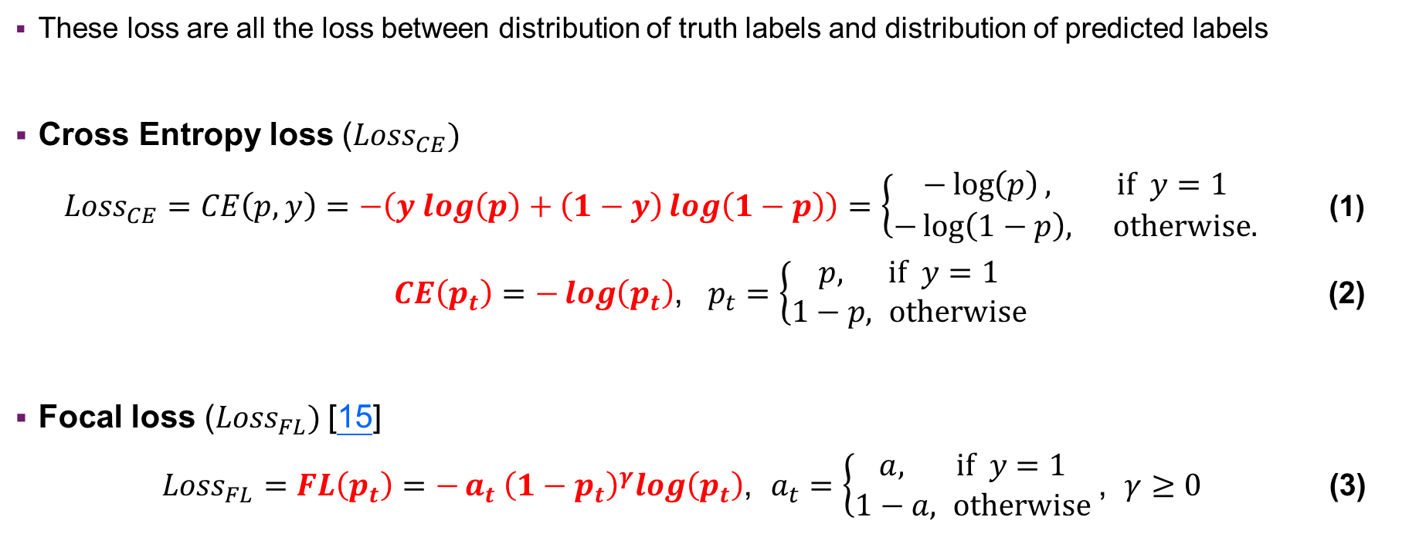
Introduction
Methods
Datasets
Experiments
Results
Related works
Loss Function
These loss are all the loss between distribution of truth labels and distribution of predicted labels
Cross Entropy loss (${Loss}_{CE})$
${Loss}_{CE}=CE\left(p, y\right)=−\left(y log\left(p\right)+\left(1−y\right)\log\left(1−p\right)\right)=\left\{\begin{aligned}−\log\left(p\right), if y=1 \\ −\log\left(1−p\right), otherwise.\end{aligned} \right.$ (1)
$CE\left(p_{t}\right)=−\log\left(p_{t}\right)$, $p_{t}=\left\{\begin{aligned}p, if y=1 \\ 1−p, otherwise\end{aligned} \right.$ (2)
Focal loss (${Loss}_{FL})$[15]
${Loss}_{FL}=FL\left(p_{t}\right)=−{a_{t} \left(1−p_{t}\right)}^{γ}log\left(p_{t}\right)$, $a_{t}=\left\{\begin{aligned}a, if y=1 \\ 1−a, otherwise\end{aligned} \right.$, $γ≥0$ (3)
Notes:
交叉熵損失（CE）度量輸出為0到1之間的概率值的分類模型的準確性。交叉熵損失隨著預測概率與實際標籤的偏離而增加，因此理想模型的損失為0。
在二進制分類中，當類別數M等於2時，交叉熵可以計算為： (1)
其中y是標籤的值，可以為0或1，而p∈[0,1]是模型對標籤y = 1的類的估計概率。 為了符號上的方便，pt由等式（2）定義並重寫：
Focal loss （FL）[15]可以被認為是一種改進的交叉熵損失，它的目的是降低簡單示例的比例，並將訓練重點放在難以分類的容易辨認錯誤的示例上。 實際上，我們使用等式（2）的α平衡變體
在分類中，用於調整具有不同類別標籤y的示例數的方法是針對y = 1引入加權因子α∈[0,1]，對於y = 0引入1-α加權因子。
然後，Focal loss將focusing parameter(調製係數)（1-p_t）^γ添加到交叉熵損失中，聚焦參數γ≥0。 當示例分類錯誤且pt小時，modulating factor(調製因子)接近1，LOSS不受影響。 當pt→1時，該因子變為0，並且損失權重降低。 當γ= 0時，FL等效於CE，並且隨著γ的增加，調製因子的作用也會增加。
我們最終使用α= 0.5和γ= 2，它們不僅可以調整示例數，而且可以專注於難以分類的示例。

Slide 14
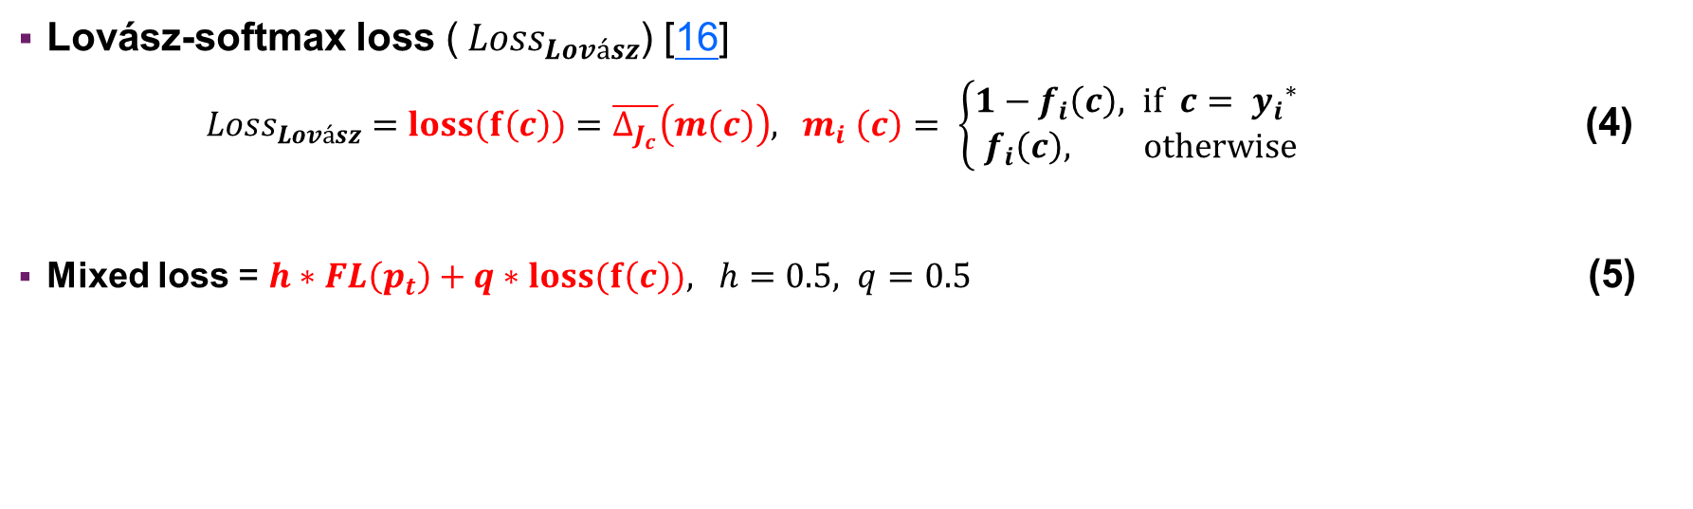
Introduction
Methods
Datasets
Experiments
Results
Related works
Loss Function
Lovász-softmax loss (${Loss}_{Lovász}$) [16]
${Loss}_{Lovász}=loss(f\left(c\right))=\overline{∆_{J_{c}}}\left(m\left(c\right)\right), { m}_{i}\left(c\right)= \left\{\begin{aligned}1−f_{i}\left(c\right), if c= {y_{i}}^{∗} \\ f_{i}\left(c\right), otherwise\end{aligned}\right.$ (4)
Mixed loss = $h∗FL\left(p_{t}\right)+q∗loss(f\left(c\right)), h=0.5, q=0.5$ (5)
Notes:
Lovász-softmax損失[16]是專門（IoU）的，也就是分割任務的Jaccard Index，可以計算為： (4)
（Δ_（J_c））̅（m）是根據Δ_（J_c）加權這些誤差m（c）的和。 ∆_（J_c）是從Jaccard索引生成的Jaccard損失，並且Jaccard損失包含一組錯誤預測，該錯誤預測是真實的負數和錯誤的正數的組合，並且是離散損失。
（∆_（J_c））̅是分段線性的，並且將R ^ p \ {0,1} ^ p中的∆_（J_c）值插值，而與{0,1上的∆_（J_c）值相同 } ^ p。
m（c）∈〖[[0,1]} ^ p是所有像素誤差的向量：
具有類別概率f_i（c）∈[0,1]，該概率由softmax函數，類別c和像素i的地面真實情況y ^ *計算得出。

Slide 15
Introduction
Methods
Datasets
Experiments
Results
Related works
Camvid :
701 images collected in street scene for autonomous driving applications. 11 classes
Original size: 720 x 960
The training, validation, and test sets contain 367, 101, and 233 images respectively.
Cityscapes:
5000 images collected in street scenes from 50 different cities. 19 classes
Original size: 1024 x 2048
The training, validation, and test sets contain 2975, 500, and 1525 images respectively.

Slide 16
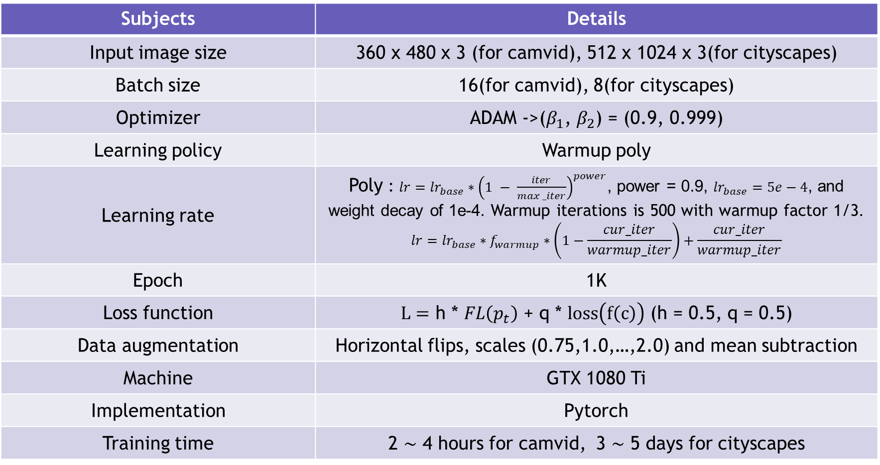
Introduction
Methods
Datasets
Experiments
Results
Related works
Subjects | Details
Input image size | 360 x 480 x 3 (for camvid), 512 x 1024 x 3(for cityscapes)
Batch size | 16(for camvid), 8(for cityscapes)
Optimizer | ADAM ->($β_{1}$, $β_{2}$) = (0.9, 0.999)
Learning policy | Warmup poly
Learning rate | Poly : $lr={lr}_{base}∗{\left(1 − \frac{iter}{max⁡_iter}\right)}^{power}$, power = 0.9, ${lr}_{base}=5e−4$, and weight decay of 1e-4. Warmup iterations is 500 with warmup factor 1/3. $${lr=lr}_{base}∗f_{warmup}∗\left(1−\frac{cur_iter}{warmup_iter}\right)+\frac{cur_iter}{warmup_iter}$$
Epoch | 1K
Loss function | $L=$ h * $FL\left(p_{t}\right)$ + q * $loss\left(f\left(c\right)\right)$ (h = 0.5, q = 0.5)
Data augmentation | Horizontal flips, scales (0.75,1.0,…,2.0) and mean subtraction
Machine | GTX 1080 Ti
Implementation | Pytorch
Training time | 2 ∼ 4 hours for camvid, 3 ∼ 5 days for cityscapes
Notes:
均值减法（Mean subtraction）是预处理最常用的形式。 它对数据中每个独立特征减去平均值，
从几何上可以理解为在每个维度上都将数据云的中心都迁移到原点。

Slide 17
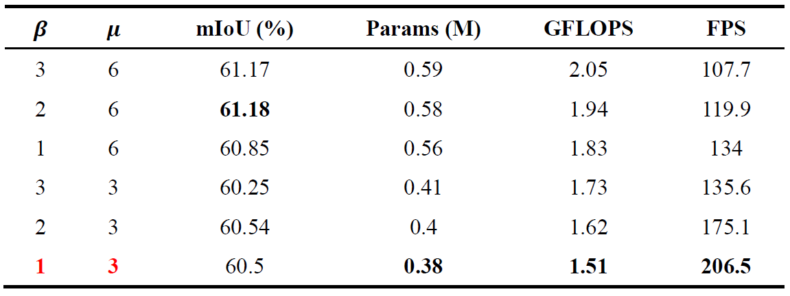
Introduction
Methods
Datasets
Experiments
Results
Related works
Comparison of different amount of OHDB blocks
https://young-gecko-59.serverless.social
Table 2. Comparison of different amount of OHDB modules in each OHDB block as $α=0.5$.
All results are on CamVid test dataset.

Slide 18
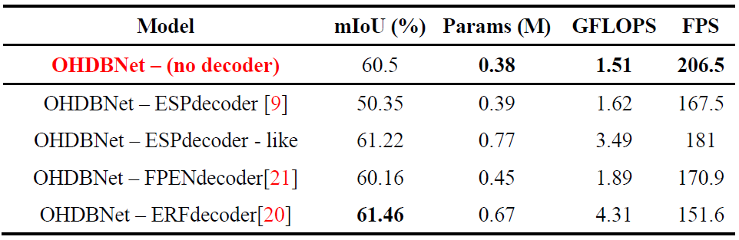
Introduction
Methods
Datasets
Experiments
Results
Related works
Comparison of different decoders for OHDBNet
Table 3. Comparison of different encoder structures for OHDBNet as $α=0.5$.
All results are on CamVid test dataset.

Slide 19
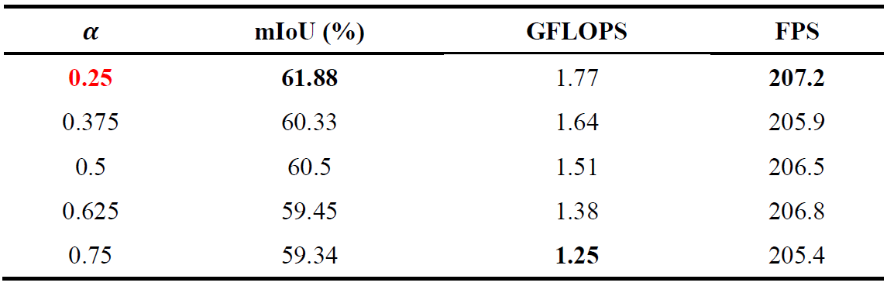
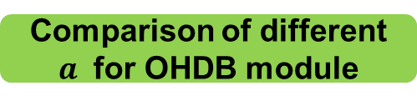
Introduction
Methods
Datasets
Experiments
Results
Related works
Comparison of different $a$ for OHDB module
Table 4. Compared with different value of $α$ for OHDB module.
All results are on CamVid test dataset.

Slide 20
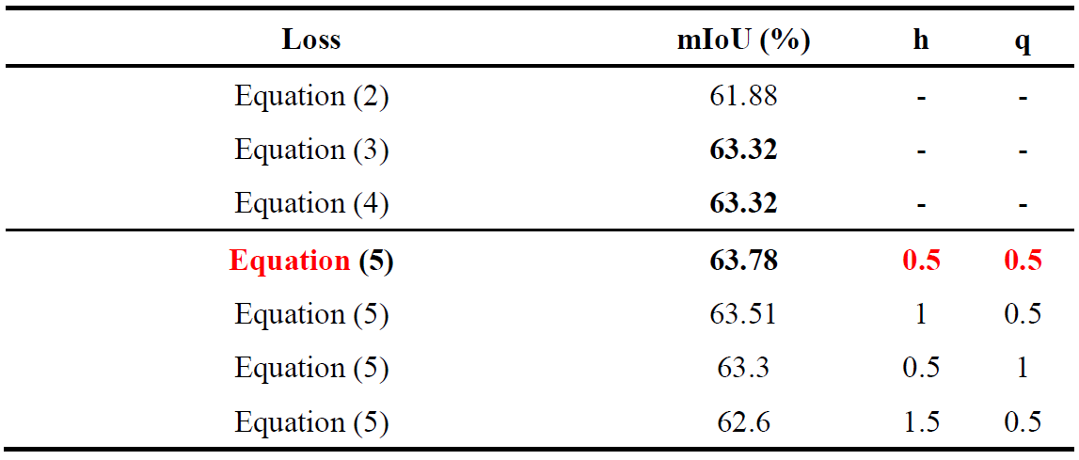
Introduction
Methods
Datasets
Experiments
Results
Related works
Comparison of different loss functions
Table 5. Compared with different loss functions and different ratio of mixed loss.
All results are on CamVid test dataset.

Slide 21
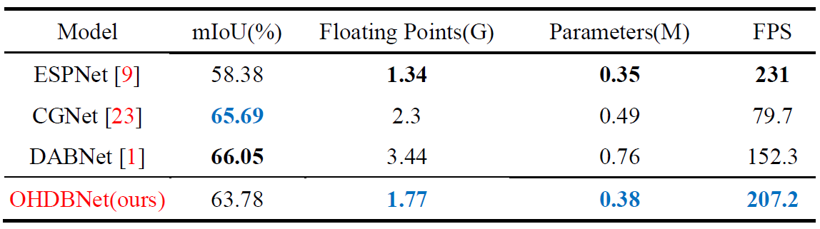
Introduction
Methods
Datasets
Experiments
Results
Related works
Comparison of other networks
Table 6. Performance on the CamVid test dataset. All networks are not pretrained. OHDBNet is indicated that our octave half dilated bottleneck network.

Slide 22
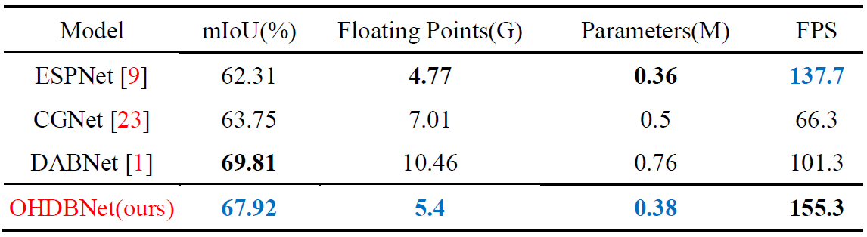
Introduction
Methods
Datasets
Experiments
Results
Related works
Comparison of other networks
Table 7. Performance on the Cityscapes validation dataset. All networks are not pretrained. OHDBNet is indicated that our octave half dilated bottleneck network.

Slide 23
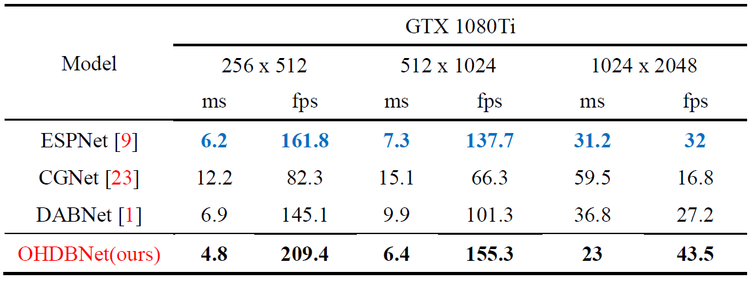
Introduction
Methods
Datasets
Experiments
Results
Related works
Comparison of other networks
Table 8. Speed comparison on the Cityscapes validation dataset.

Slide 24
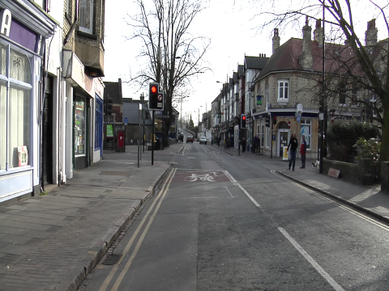
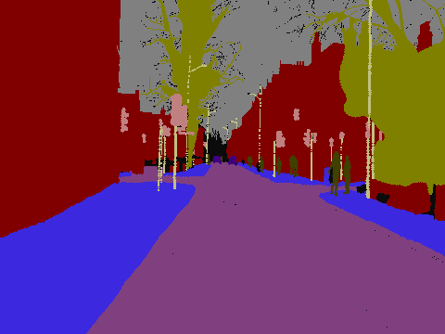
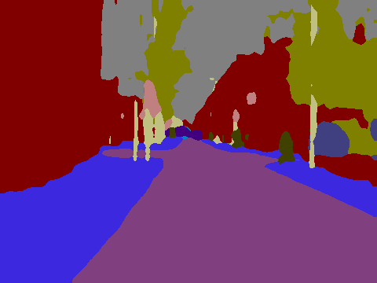
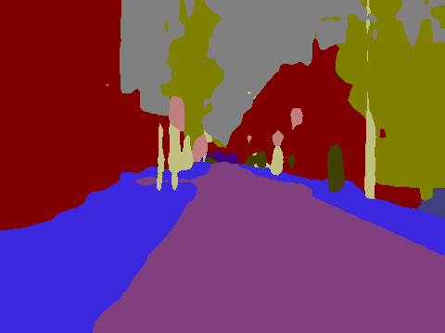
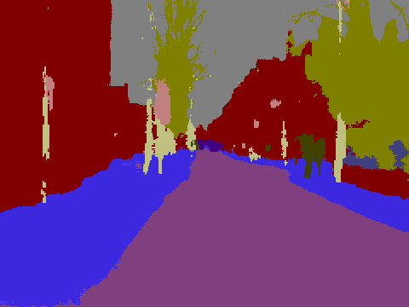
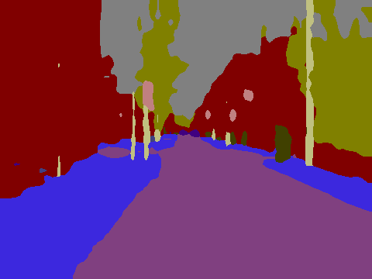
Introduction
Methods
Datasets
Experiments
Results
Related works
(a) Image
(b) Ground truth
(c) DABNet
(d) CGNet
(e) ESPNet
(f) OHDBNet(ours)
Figure 6. The results of our network and others on Camvid test set.

Slide 25
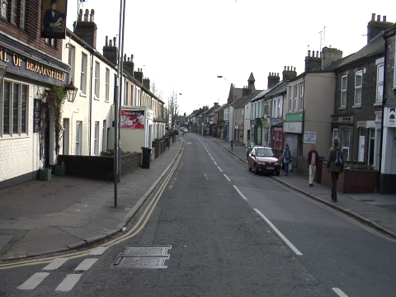





Introduction
Methods
Datasets
Experiments
Results
Related works
(a) Image
(b) Ground truth
(c) DABNet
(d) CGNet
(e) ESPNet
(f) OHDBNet(ours)
Figure 7. The results of our network and others on Camvid test set.

Slide 26






Introduction
Methods
Datasets
Experiments
Results
Related works
(a) Image
(b) Ground truth
(c) DABNet
(d) CGNet
(e) ESPNet
(f) OHDBNet(ours)
Figure 8. The results of our network and others on Cityscapes validation set.

Slide 27





Introduction
Methods
Datasets
Experiments
Results
Related works
(a) Image
(b) Ground truth
(c) DABNet
(d) CGNet
(e) ESPNet
(f) OHDBNet(ours)
Figure 9. The results of our network and others on Cityscapes validation set.

Slide 28






Introduction
Methods
Datasets
Experiments
Results
Related works
(a) Image
(b) Ground truth
(c) DABNet
(d) CGNet
(e) ESPNet
(f) OHDBNet(ours)
Figure 10. The results of our network and others on Cityscapes validation set.

Slide 29






Introduction
Methods
Datasets
Experiments
Results
Related works
(a) Image
(b) Ground truth
(c) DABNet
(d) CGNet
(e) ESPNet
(f) OHDBNet(ours)
Figure 11. The results of our network and others on Cityscapes validation set.

Slide 30






Introduction
Methods
Datasets
Experiments
Results
Related works
(a) Image
(b) Ground truth
(c) DABNet
(d) CGNet
(e) ESPNet
(f) OHDBNet(ours)
Figure 12. The results of our network and others on Cityscapes validation set.

Slide 31






Introduction
Methods
Datasets
Experiments
Results
Related works
(a) Image
(b) Ground truth
(c) DABNet
(d) CGNet
(e) ESPNet
(f) OHDBNet(ours)
Figure 13. The results of our network and others on Cityscapes validation set.

Slide 32
Introduction
Methods
Datasets
Experiments
Results
Related works
OHDBNet Conclusions
OHDB module can achieve high inference speed, less parameters and less computational cost.
Mixed loss helps the network adjust the number of examples but also focus on hard, misclassified examples, and then optimize the Jaccard Index (IoU) to get higher mIoU.

Slide 33

Reference
Gen Li, Inyoung Yun, Jonghyun Kim, and Joongkyu Kim, “DABNet: Depth-wise Asymmetric Bottleneck for Real-time Semantic Segmentatio,” In BMVC, 2019.
Liang-Chieh Chen, George Papandreou, Iasonas Kokkinos, Kevin Murphy, and Alan Loddon Yuille, “Semantic image segmentation with deep convolutional nets and fully connected crfs,” CoRR, abs/1412.7062, 2015.
Liang-Chieh Chen, George Papandreou, Florian Schroff, and Hartwig Adam, “Rethinking atrous convolution for semantic image segmentation,” CoRR, abs/1706.05587, 2017.
Liang-Chieh Chen, George Papandreou, Iasonas Kokkinos, Kevin Murphy, and Alan Loddon Yuille, “Deeplab: Semantic image segmentation with deep convolutional nets, atrous convolution, and fully connected crfs,” IEEE Transactions on Pattern Analysis and Machine Intelligence, 40:834–848, 2018.
Liang-Chieh Chen, Yukun Zhu, George Papandreou, Florian Schroff, and Hartwig Adam, “Encoder-decoder with atrous separable convolution for semantic image segmentation,” In ECCV, 2018.
Yi-Hsuan Tsai, Wei-Chih Hung, Samuel Schulter, Kihyuk Sohn, Ming-Hsuan Yang, Manmohan Chandraker, “Learning to Adapt Structured Output Space for Semantic Segmentation,” arXiv:1802.10349, 2018.
Chen-Wei Xie, Hong-Yu Zhou, and Jianxin Wu, “Vortex Pooling: Improving Context Representation in Semantic Segmentation,” arXiv:1804.06242v2, 2018.
Paszke, A., Chaurasia, A., Kim, S., Culurciello, E., “Enet: A deep neural network architecture for real-time semantic segmentation,” arXiv:1606.02147v1, 2016.

Slide 34
Reference
Sachin Mehta, Mohammad Rastegari, Anat Caspi, Linda Shapiro, and Hannaneh Hajishirzi, “ESPNet: Efficient Spatial Pyramid of Dilated Convolutions for Semantic Segmentation,” In ECCV, 2018.
Yunpeng Chen, Haoqi Fan, Bing Xu, Zhicheng Yan, Yannis Kalantidis, Marcus Rohrbach, Shuicheng Yan, and Jiashi Feng, “Drop an Octave: Reducing Spatial Redundancy in Convolutional Neural Networks with Octave Convolution,” In ICCV, 2019.
Matthias Holschneider, RichardKronland-Martinet, JeanMorlet, and Ph Tchamitchian, “A real-time algorithm for signal analysis with the help of the wavelet transform,” In Wavelets, pages 286–297. Springer, 1990.
Kaiming He, Xiangyu Zhang, Shaoqing Ren, and Jian Sun, “Deep residual learning for image recognition,” In Proceedings of the IEEE conference on computer vision and pattern recognition, pages 770–778, 2016.
Kaiming He, Xiangyu Zhang, Shaoqing Ren, and Jian Sun. Delving deep into rectifiers, “Surpassing human-level performance on imagenet classification,” In Proceedings of the IEEE international conference on computer vision, pages 1026–1034, 2015.
J. Cheng, L. Dong, and M. Lapata, “Long short-term memory-networks for machine reading,” arXiv:1601.06733, 2016.
Tsung-Yi Lin, Priya Goyal, Ross Girshick, Kaiming He, and Piotr Dollár, “Focal Loss for Dense Object Detection,” arXiv:1708.02002v2, 2018.
Maxim Berman, Amal Rannen Triki, and Matthew B. Blaschko, “The Lovász-Softmax loss: A tractable surrogate for the optimization of the intersection-over-union measure in neural networks,” In CVPR, 2018.

Slide 35
Reference
Liang-Chieh Chen, George Papandreou, Iasonas Kokkinos, Kevin Murphy, and Alan Loddon Yuille, “Semantic image segmentation with deep convolutional nets and fully connected crfs,” CoRR, abs/1412.7062, 2015.
Marius Cordts,Mohamed Omran, Sebastian Ramos, Timo Rehfeld,Markus Enzweiler, Rodrigo Benenson, Uwe Franke, Stefan Roth, and Bernt Schiele, “The cityscapes dataset for semantic urban scene understanding,” 2016 IEEE Conference on Computer Vision and Pattern Recognition (CVPR), pages 3213–3223, 2016.
Diederik P. Kingma, and Jimmy Ba, “Adam: A Method for Stochastic Optimization,” arXiv:1412.6980, 2014.
Eduardo Romera, Jose M. Alvarez, Luis M. Bergasa1 and Roberto Arroyo1, “ERFNet: Efficient Residual Factorized ConvNet for Real-time Semantic Segmentation,” In CVPR 2018.
Mengyu Liu, and Hujun Yin, “Feature Pyramid Encoding Network for Real-time Semantic Segmentation,” In BMVC, 2019.
Alex Kendall, “SegNet and Bayesian SegNet Tutorial,” http://mi.eng.cam.ac.uk/projects/segnet/tutorial.html
Tianyi Wu, Sheng Tang, Rui Zhang, Yongdong Zhang, “CGNet: A Light-weight Context Guided Network for Semantic Segmentation,” arXiv:1811.08201v2, 2019.

Slide 36
Q
A

